Slide 1
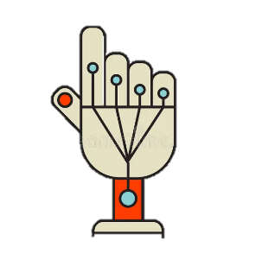
Gesture controlled gaming glove
Embedded Systems

Slide 2
Embedded systems
Dr Musa ALYAMAN
Asya Samer
Dana Abu Al Ruz
Ethar Al Salameh
Layla Al Laham
Jana Saleh Godieh
Leen Al Masarweh

Slide 3
Presentation outline
Level 5
connections
Level 4
Algorithms
Level 6
Sketch
Level 1
Level 3
introduction
Flowchart
Level 7
Conclusion
Level 2
Hardware
Final boss
Testing

Slide 4
1. Introduction
Gesture controlled gaming glove
A gaming glove that captures simple hand
gestures and uses them to explore and
control games for a more immersive and
enjoyable gaming experience

Slide 5
Project motivation
Make gaming accessible for users with amputations, disability and limited mobility
Create a fun, intuitive control system using gestures
Affordable alternative to expensive VR systems

Slide 6
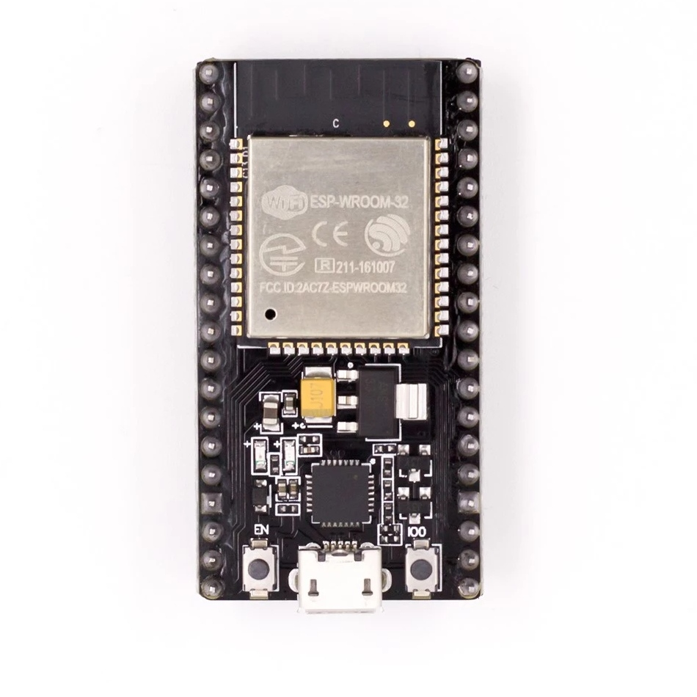
2. Hardware
ESP32 Microcontroller
This board is the brain of the system.
It reads data from the sensors and
sends it to the laptop via Wi-Fi using
UDP protocol. We chose the ESP32
because it’s powerful, has great
connectivity options, and works well
in small wearable setups.

Slide 7
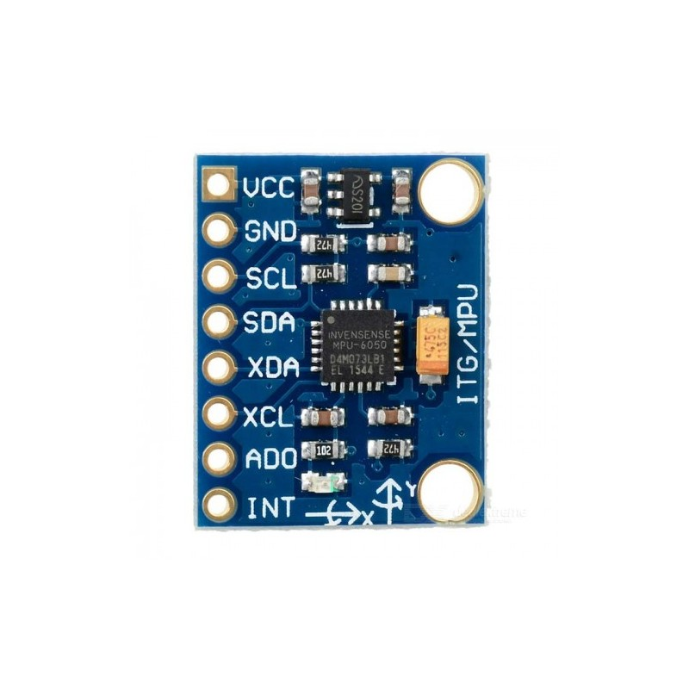
2. Hardware
MPU6050
This small sensor combines an accelerometer and a gyroscope, allowing us to detect movement and direction

Slide 8
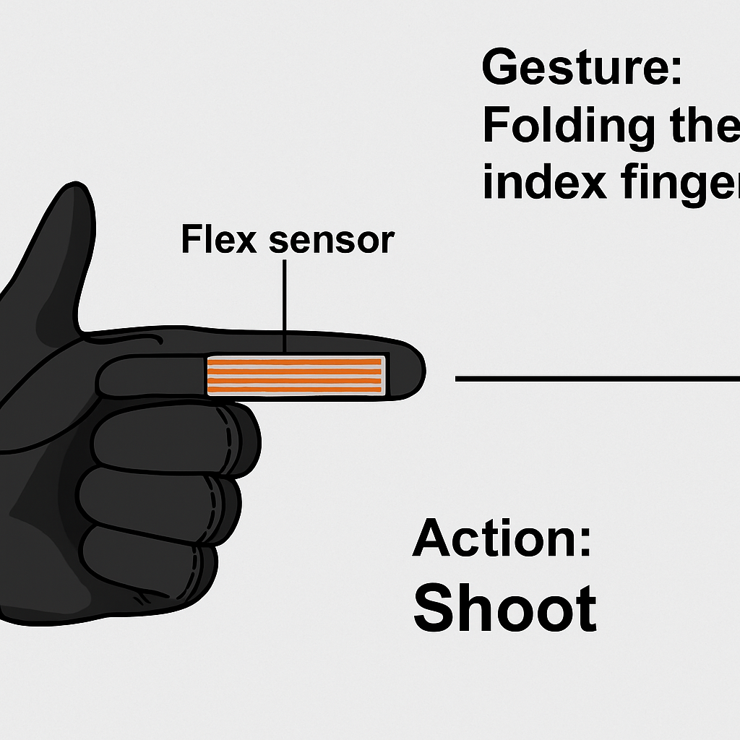
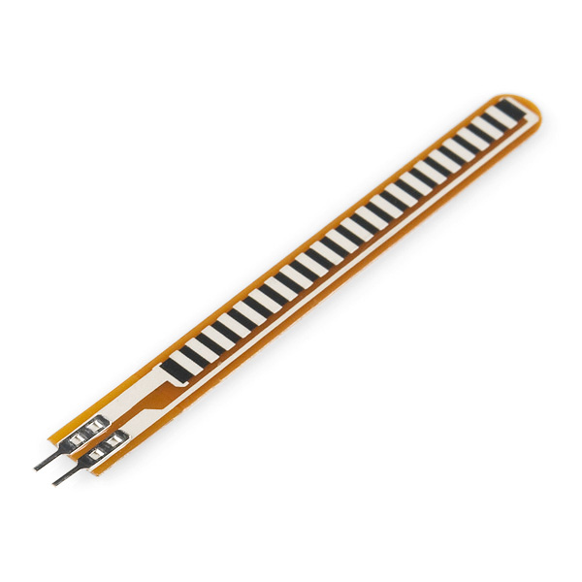
2. Hardware
Flex sensor
The flex sensor, which is strapped to the index finger using a silicone glove, gives analog readings to the ESP32.

Slide 9
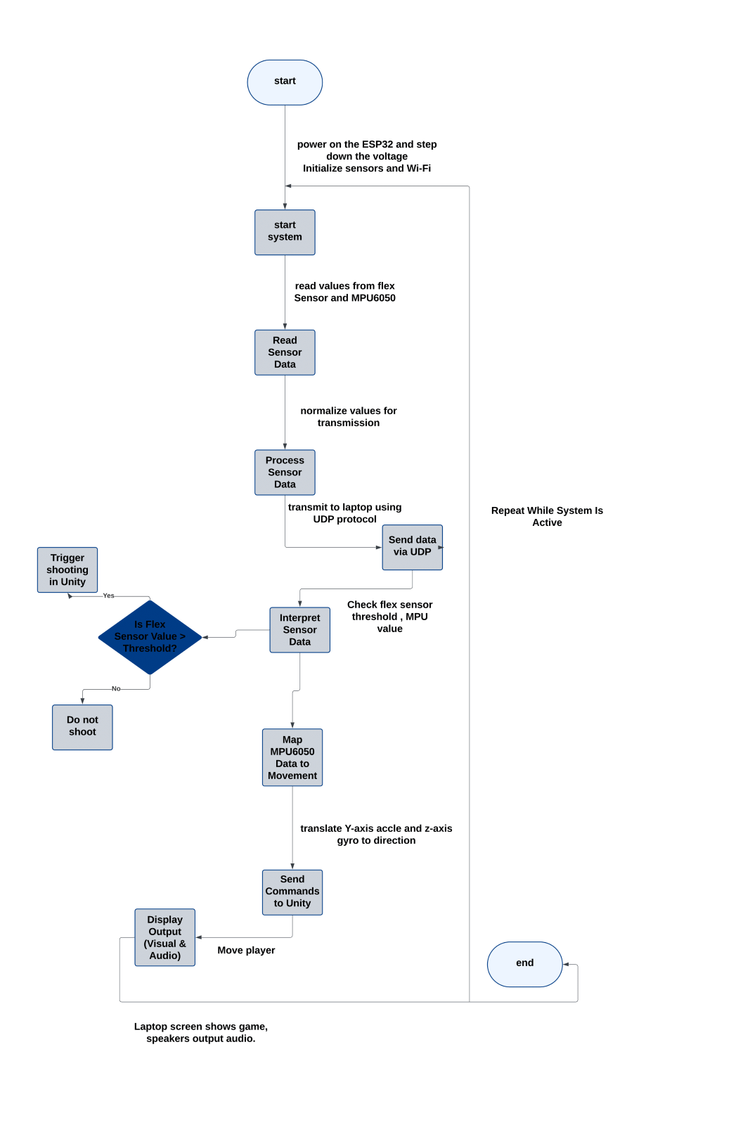
3.Flowchart
Power On and System Initialization Sensor Data Acquisition
Data Transmission using UDP
Data Processing in Python Script
Gesture-to-Action Mapping
Unity Game Control
Visual and Audio Feedback

Slide 10
4.Description of algorithms that controls the systems operation
Continuous Loop:
The system runs in a continuous loop:
Sensors continue to receive new input.
Data is sent to the laptop.
Python updates a txt file read by the Unity game code
The loop ensures the player gestures are consistently updated on the game without delays.

Slide 11
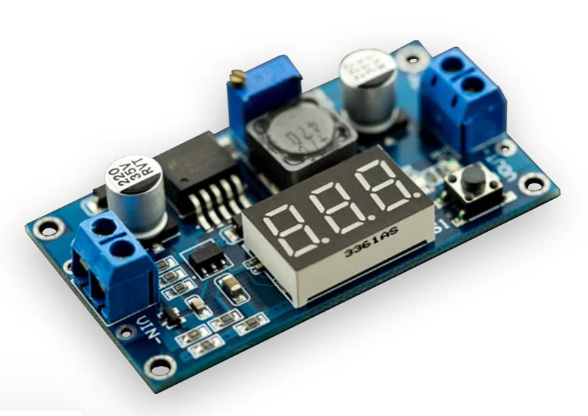
Description of algorithms that controls the systems operation
Power On and System Initialization
The system runs on a 7.4V Li-ion battery, which is regulated down to 5V by a voltage regulator to supply the ESP32.
Once powered, the ESP32 initializes the necessary GPIOs and I2C communication with mounted sensors (flex sensor and MPU6050). It also establishes a UDP connection to the laptop.

Slide 12
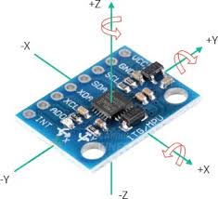
Description of algorithms that controls the systems operation
Sensor Data Acquisition:
The flex sensor, which is strapped to the index finger using a silicone glove, gives analog readings to the ESP32.
The MPU6050, contained in a 3D-printed case in the glove's rear, gives the gyroscope readings (movement Y-axis, rotation Z-axis) constantly through I2C.
The ESP32 reads these values in real time and prepares them to send.

Slide 13

Description of algorithms that controls the systems operation
Data Transmission using UDP:
ESP32 transmits the sensor readings collected wirelessly to the laptop using UDP protocol. This ensures low-latency transmission for fast gameplay.

Slide 14

Description of algorithms that controls the systems operation
Data Processing in Python Script:
The laptop hosts a Python script that reads serial output and writes it on a txt file that the Unity game code checks :
If the value of the flex sensor goes over a shooting threshold.
If MPU6050 values indicate forward/backward movement or left/right turning.

Slide 15
Description of algorithms that controls the systems operation
Gesture-to-Action Mapping:
The unity code interprets the sensor readings to respective game actions:
Finger fold (flex sensor) → shoots the weapon.
Move forward/backward (MPU6050 Y-axis) → moves the player forward/backward.
Turn left/right (MPU6050 Z-axis) → turns the direction of the player.
These commands are communicated to the Unity game environment.

Slide 16
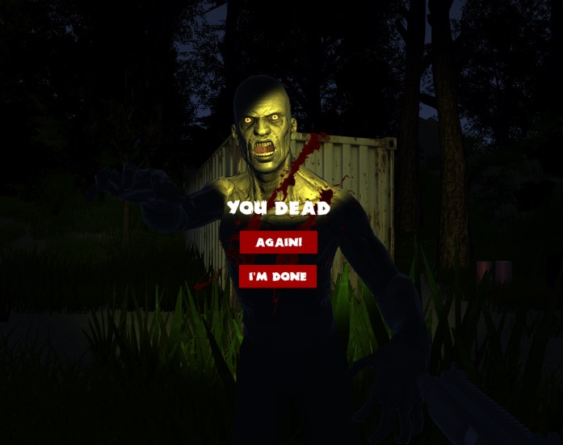
Description of algorithms that controls the systems operation
Visual and Audio Feedback:
The laptop screen (visual actuator) displays the game, and the laptop speakers (audio actuator) provide sound effects such as footsteps, guns, or zombie screams. These feedbacks are a result of the player's actions and maintain the player engaged.

Slide 17
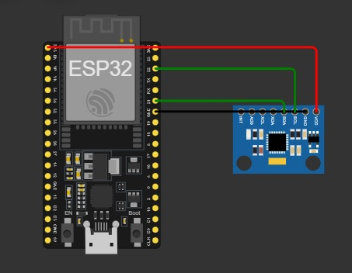
5.Connections
Component | Pin on Component | Connects To ESP32 Pin
MPU-6050 | VCC | 3.3v
 | GND | GND
 | SCL | GPIO 22
 | SDA | GPIO 21

Slide 18
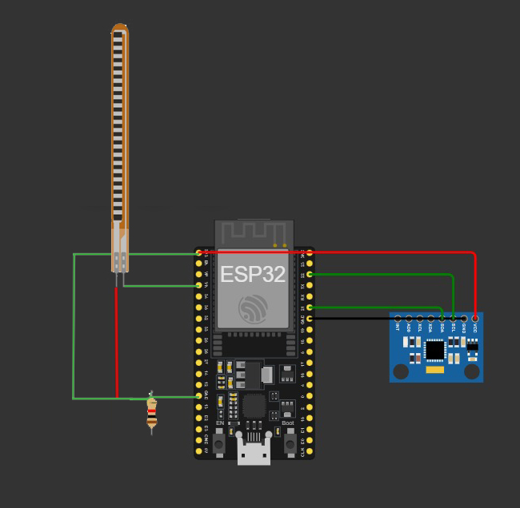
Connections
Component | Pin on Component | Connects To ESP32 Pin
Flex sensor | One side | 3.3v
 | Other side | GND through resistor
 | midpoint | GPIO 34

Slide 19
6.Conclusion
In this project, we designed and built a gaming gesture glove that lets players control a game using hand movements. We tested it on a zombie-killer game to show how it works in a real gaming situation. While the main goal was to make gameplay more fun and interactive, our project also has the potential to make an economic impact.

Slide 20
7.Expected impact and future opportunities
Award 1
Award 2
Award 3
Award 4
A Cheaper Option for Motion Control
New Opportunities in the Gaming Market
Rehabilitation
Semulation training
Education
Encouraging innovation and tech skills

Slide 21
Testing!

